Slide 1
21st Century Implementation and the Next Big Things
TCCIL 10/09/14

Slide 2
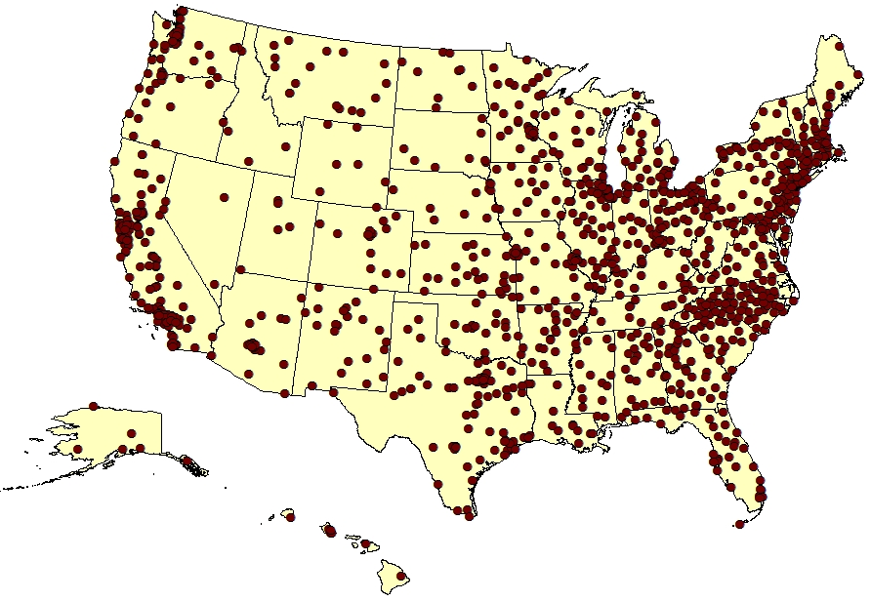
Community Colleges Growth by Decade
American Association of Community Colleges
Community Colleges in the U.S.
Decade | # of CCs
2011 | 12
2000 | 49
1990 | 48
1980 | 149
1970 | 497
1960 | 82
1950 | 92
1940 | 58
1930 | 106
1920 | 49
1910 | 25
4
2014
25

Slide 3
America’s more than 1100 Community Colleges Educate
46% of all U.S. undergraduates
50% of new nurses and the majority of health care workers
80% of credentialed first responders including firefighters, EMTs, and law enforcement officers
More than 50% of minority undergraduates
57% of adult learners 40 to 65 years of age

Slide 4
12.7 Million Total Enrollment (Fall 2012)
Source: (2012). AACC analysis of Integrated Postsecondary Education Data System of Fall 2012 Survey data file and AACC membership database.

Slide 5
“This is THE Camelot moment for community colleges – this brief shining moment in time, where the promise of the future that community colleges can provide for the nation’s citizenry has been realized.” ~ Walter G. Bumphus

Slide 6
A bit of good news on retention and persistence

Slide 7
Number of Certificates increased by more than 40,000 (9.8 percent)
Number of Associate degrees increased by more than 55,000 (8.2 percent)
Notes:
The three most recent years worth of data on completions indicate that community colleges are increasing the number of certificates and associate degrees awarded—nearly 10% more in 2012-13 than were awarded in 2010-11. Community colleges awarded 55,000 more associate degrees in 2012-13 than they did in 2010-11.
Source: AACC analysis of Integrated Postsecondary Education Data System (IPEDS) completions Files 2011, 2012, 2013; National Center for Education Statistics, U.S. Education Department.

Slide 8
Best of Times for Community Colleges
Increased presence in the spotlight
The White House Summits on Community Colleges and College Opportunity
Prominent role in workforce training and economic development
College affordability
College readiness
Transfer

Slide 9
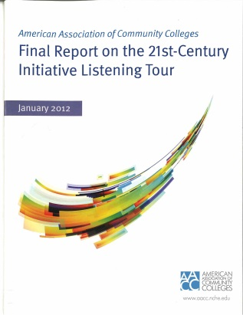
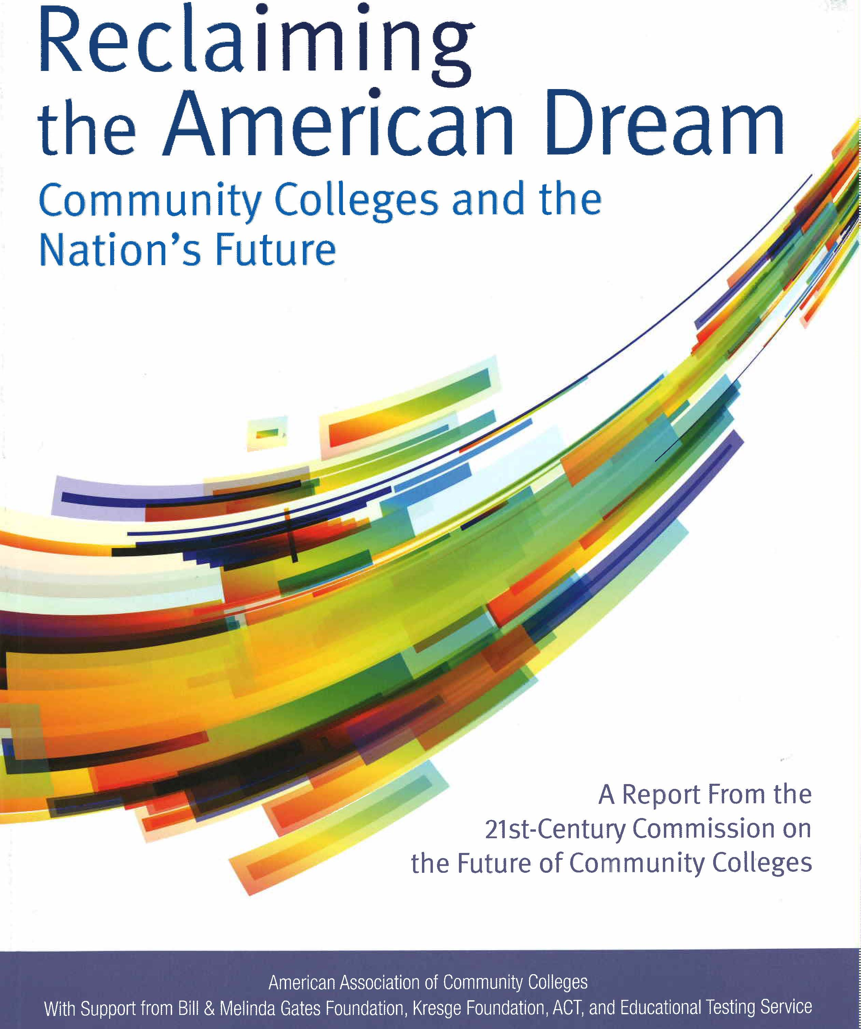
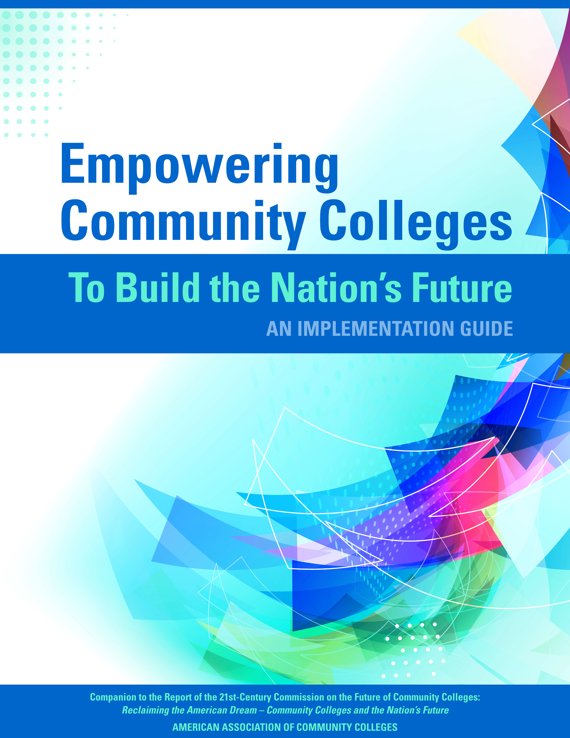
AACC’s Three Pronged Approach
Listening Tour
2011
21st-Century Commission
2012-2013
21st-Century Implementation
2013-2014
Broad stakeholder feedback
38 CEOs, friendly critics and thought leaders
112 leaders divided into 9 teams

Slide 10
Faculty and Staff Engagement is essential to improving student outcomes
Faculty and staff must be:
Empowered to lead change
Engaged in open and frank discussions about why student success matters
Willing to draw on each others strengths and expertise
In the case of faculty, be willing to redesign pedagogy and course content to meet the needs of the 21st Century student; staff must be willing to redesign the ways in which the institution serves students

Slide 11
Faculty and Staff Engagement continued
Full-time and part-time faculty must work together to strengthen learning outcomes and student success.
Full-time faculty should mentor part-time faculty
Institution should provide a certification program for part-time faculty, where they can practice effective teaching methods
Faculty leaders should developing professional development that leads to improved learning outcomes; staff should engage in professional development to better understand how their roles support what is being done in the classroom.

Slide 12
7 Recommendations address the Three
Recommendations
1, 2, & 3
Redesign
9 Strategies
Recommendations
4 & 5
Reinvent
4 Strategies
Recommendations
6 & 7
Reset
9 Strategies

Slide 13
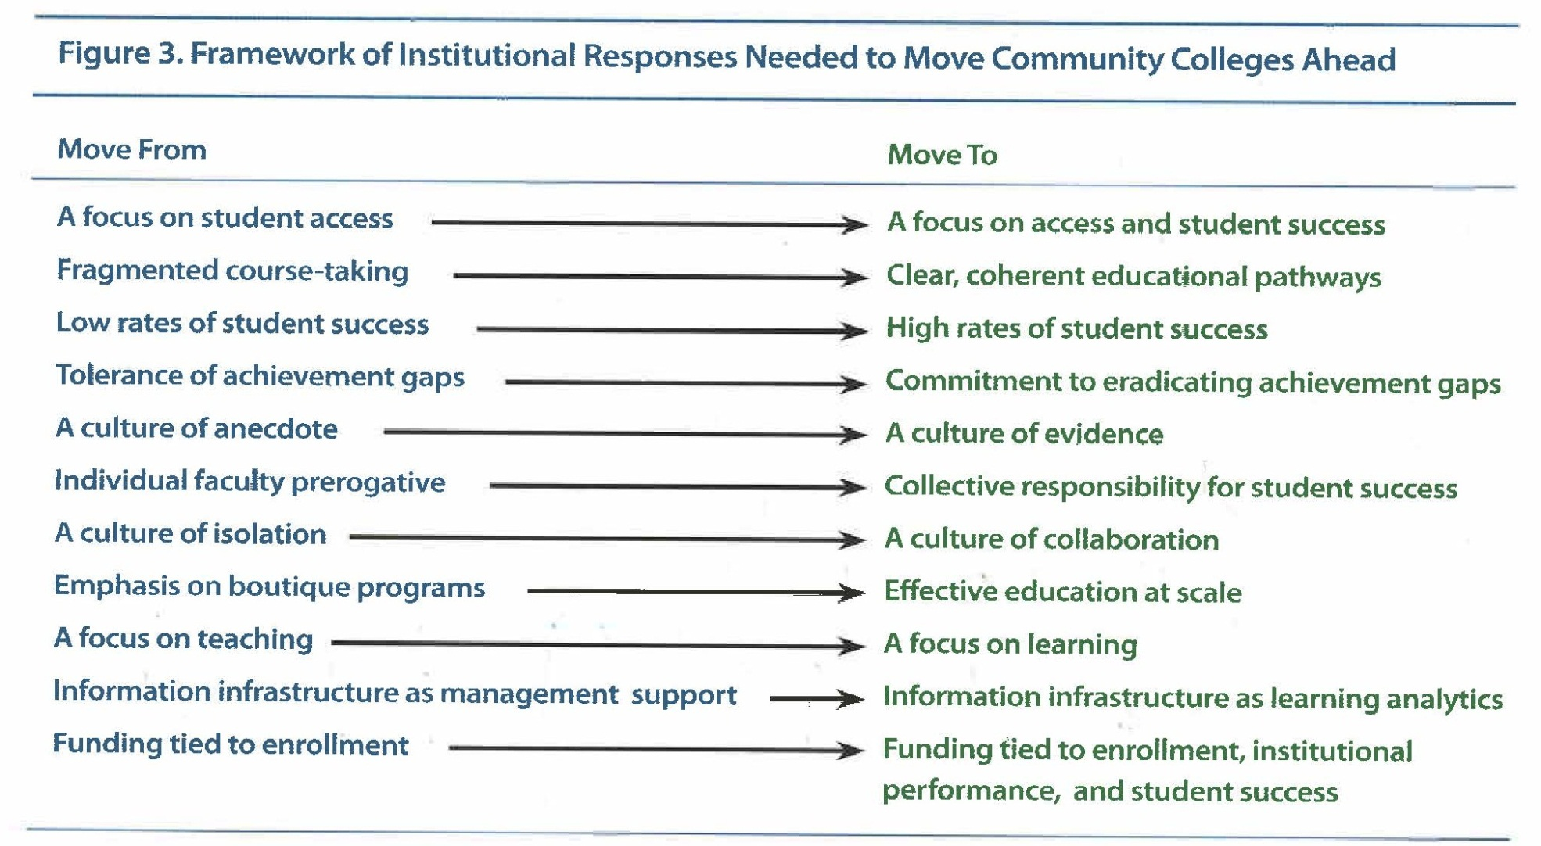
In order to serve the 21st Century student we must move from…to

Slide 14
The Implementation Guide

Slide 15
Increase Completion Rates by 50%
Increase completion rates of students earning community college credentials (certificates and associate degrees) by 50% by 2020, while preserving access, enhancing quality, and eradicating attainment gaps associated with income, race, ethnicity, and gender.
Examples of actions:
Create pathways
Establish guarantees for seamless transfer
Implement reverse transfer agreements

Slide 16
Dramatically improve college readiness
Dramatically improve college readiness: By 2020, reduce by half the numbers of students entering college unprepared for rigorous college-level work, and double the number of students who complete developmental education programs and progress to successful completion of related freshman-level courses.
Examples of actions:
Participate in implementation of the Common Core State Standards (CCSS) or their equivalent in non-CCSS states
Collaborate with K–12 partners
Redesign developmental education

Slide 17
Close the American Skills Gap
Close the American skills gap by sharply focusing career and technical education on preparing students with the knowledge and skills required for existing and future jobs in regional and global economies.
Examples of actions:
Develop career pathways for current and future jobs
Redesign student experiences to incorporate more work-based, hands-on, and technology-enriched learning

Slide 18
Refocus and Redefine
Refocus the community college mission and redefine institutional roles to meet 21st century education and employment needs.
Examples of actions:
Strengthen the role of community colleges in advising, learning assessment, and credentialing
Redefine faculty roles
Create conditions in which part-time faculty can make their best contributions to student success

Slide 19
Collaborative Support Structures
Invest in support structures to serve multiple community colleges through collaboration among institutions and with partners in philanthropy, government, and the private sector.
Examples of actions:
Develop models for collaborative support structures and brokered/coordinated services
Create statewide and border-crossing data systems
Create consortia to optimize the capacities of collaborating institutions

Slide 20
Advocacy
Target public and private investments strategically to create new incentives for institutions of education and their students and to support community college efforts to reclaim the American Dream.
Examples of actions:
Promote college completion
Build seamless transitions across education sectors
Connect education and jobs

Slide 21
Accountability
Implement policies and practices that promote rigor, transparency, and accountability for results in community colleges.
Examples of actions:
Implement the VFA
Encourage colleges nationwide to adopt the VFA, and promote statewide participation
Position the VFA as the standard for measuring community college performance
Establish an annual evaluation of the VFA’s effectiveness

Slide 22
Community College Performance
More focus on innovation and inclusion
Increased attention to retention
Uptick in student success
Accelerated developmental education
Equal completion amongst diverse student populations

Slide 23
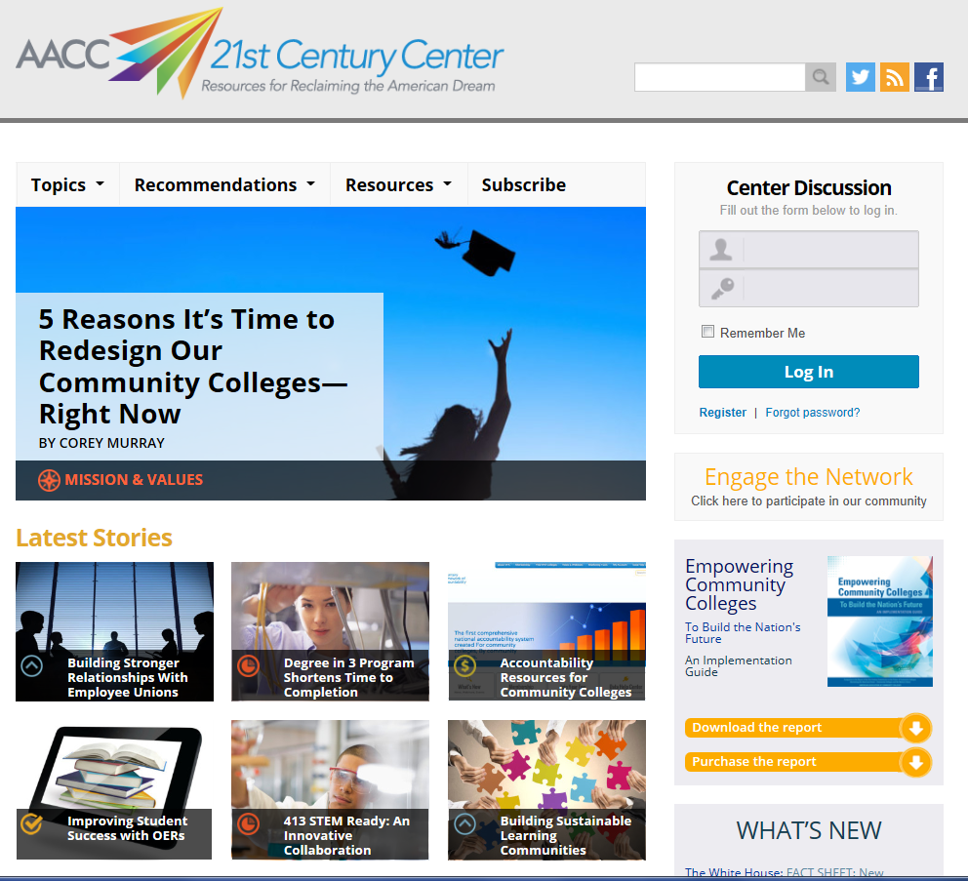
The 21st Century Center

Slide 24
Trends and Issues
College readiness and pathways
Common Core State Standards
Programs for veterans
Developmental Education Redesign
Global and International Programs
Sexual Assaults on Campus
Community colleges offering bachelor’s degrees
Income Inequality

Slide 25
Next Big Things
Intensified commitment to college completion
Strengthening community college accountability
Supporting work to design and implement pathways
National summit on college readiness and developmental education redesign

Slide 26
Next Big things continued
Creating a seamless education and career system
Building stackable credentials and a national credentialing system
Strengthening apprenticeship opportunities

Slide 27
Walter G. Bumphus, Ph.D.
President and CEO
American Association of Community Colleges
One Dupont Circle, NW, Suite 410
Washington, DC 20036
202.728.0200, Ext. 238
http://www.aacc.nche.edu
Notes:
27

