Slide 1
Community College Excellence: Lessons from the field
Presentation to:
Texas Community College Instructional Leaders
October 8, 2014
Joshua S. Wyner
Vice President,
Executive Director, College Excellence Program
The Aspen Institute

Slide 2
Winners and Finalists
Santa Barbara City College, Santa Barbara, CA (2013)
Valencia College, Orlando, FL (2011)
Walla Walla Community College, Walla Walla, WA (2013)
Kingsborough Community College, Brooklyn, NY (2013)
Lake Area Technical Institute, Watertown, SD (2011, 2013)
Miami-Dade College, Miami, FL (2011)
West Kentucky Community & Technical College, Paducah, KY (2011)
Brazosport College, Lake Jackson, TX
Broward College, Ft. Lauderdale, FL
College of the Ouachitas, Malvern, AR
El Paso Community College, El Paso, TX
Hostos Community College, Bronx, NY
Indian River State College, Fort Pierce, FL
Kennedy-King College, Chicago, IL
Mississippi Gulf Coast Community College, Perkinston, MS
Mott Community College, Flint, MI
Northeast Iowa Community College, Calmar, IA
Olympic College, Bremerton, WA
Renton Technical College, Renton, WA
Santa Fe College, Gainesville, FL
Southeast Kentucky Community & Technical College, Cumberland, KY
Southwest Texas Junior College, Uvalde, TX
Winners
Finalists w/Distinction
Finalists
Notes:
Three major challenges all community colleges are grappling with:
Low levels of completion for developmental education students – Largest part of low completion rates is underprepared students not attaining credentials
Budget Pressures – Decreasing state appropriations and local tax revenue
Accountability – Increasing expectations for student success from multiple stakeholders

Slide 3
Four Measures of Community College Excellence
Learning outcomes
Completion outcomes
Labor market outcomes
Equity in outcomes
High absolute performance
Improvement over time

Slide 4
Outcomes of Prize Finalist Colleges
Completion/transfer rates that far surpass the national average

Slide 5
Outcomes of Prize Finalist Colleges
Exceptional improvements over time in completion
Increase in the number of credentials awarded at Valencia College, 2002-2011
AA, AS/AAS Degrees and Certificates/Diplomas Awarded
84% increase over 6 years
46% increase over 6 years
66% increase over 6 years

Slide 6
Outcomes of Prize Finalist Colleges
Far greater equity in outcomes than the national average
Three-year completion and/or transfer rates for underrepresented
minority students compared to the national average
Brazosport College (TX)
Santa Barbara City College (CA)
Santa Fe College (FL)
Notes:
[inserting info from slide on original pg 7 which has been deleted]
Exceptional equity in access for underepresented populations
Top three performers: CUNY Kingsborough 1%, Walla Walla Community College 6%, Broward College 13%

Slide 7
Outcomes of Prize Finalist Colleges
Exceptional short-term labor market outcomes for graduates
Average salaries of recent graduates compared to the average for all new-hires
in the region (top three performers)
82%
above avg.
Regional average
79%
above avg.
Regional average
Regional average
40%
above avg.

Slide 8
Outcomes of Prize Finalist Colleges
Exceptional long-term labor market outcomes
Average salaries of graduates 5 years after graduation compared
to the average for all workers in the region (top three performers)
Regional average
65%
above avg.
Regional average
38%
above avg.
Regional average
55%
above avg.

Slide 9
Lessons from the Aspen Prize for Community College Excellence

Slide 10
Themes characterizing the institutions that achieve
exceptional outcomes for students:
1
Strong leadership and vision
2
Clear pathways to credentials and other intentional structures to support students
3
Intentional focus on improving teaching and learning
4
Consistent, systematic, and strategic use of data to improve practice
5
Integrated structures that link the college to the broader community for the benefit of students
Notes:
Aspen Prize finalist colleges demonstrated intentional strategies for addressing the challenges of completion, budget pressures, and accountability, while always staying focused on student success. These strategies are evident throughout the five themes of exceptional practices that emerged from site visits.

Slide 11


Theme 1
Strong Leadership and Vision
Notes:
Communicate a clear vision focused explicitly on student success, and ensure that all the institution’s work and resources aim towards that goal
Inspire and sustain a change in culture towards innovation, data-informed practice, and shared responsibility for student success
Consistently act in ways that make clear that their central concern is student success, including by taking risks
Develop strong external partnerships that support student success

Slide 12
Exceptional colleges have strong executive leaders:
Communicate a clear vision focused explicitly on student success, and ensure that all the institution’s work and resources aim towards that goal.
Notes:
Communicating a consistent, clear and compelling vision of excellence that is tied to student success in learning, completion, equity and post-graduation success
Creating and maintaining urgency to improve student success
Leading development of strong unified plans aligned to student goals
Maintaining strong relationships with faculty and staff

Slide 13
Exceptional colleges have strong executive leaders:
Inspire and sustain a change
in culture towards innovation, data-informed practice, and shared responsibility for student success.
Notes:
Analyzing data to understand gaps in student success and routinely sharing those data in readily accessible ways
Modeling and rewarding action based on innovative thinking
Maintaining a continuous improvement mindset by always asking, What are we doing, why are we doing it, are we having an impact at scale, and how do we know?
Aligning resources to student success goals
Monitoring implementation and evaluating success, leading to actions that include stopping interventions that don’t work

Slide 14
Exceptional colleges have strong executive leaders:
Consistently act in ways that make clear that their central concern is student success, including by taking risks.
Notes:
Budgeting and reallocating resources in ways that are evidence-based and aligned with continued improvement
Hiring cabinet-level staff and others who share in ownership of student success goals and drive processes of engagement and change
Leading strategic planning processes aimed at shared, clear, informed diagnoses of problems and concrete plans for improvement
Raising funds in ways that align directly with student success goals and keep focus on the core business of the college as student success

Slide 15
Exceptional colleges have strong executive leaders:
Develop strong external partnerships that support student success.
Notes:
Building structures to link college with K-12 systems and four-year colleges and create seamless pathways for students
Building structures to engage employers in defining what they need from graduates and placing students directly into employment
Demonstrating clearly to legislators and other public officials the value of the community college, its mission, and its unique role in advancing the democratic and economic health of the state and region

Slide 16
Valencia College
President Sandy Shugart aligns highly effective change management processes to sustainable college-wide focal points – called “Big Ideas” – that reflect shared visions of what most needs to be done to advance student success.
Result: Sustained, dramatic improvements in completion rates.
Notes:
President Sandy Shugart uses his position to sustain a college-wide focus on the big picture of what matters most for student success.
Shugart shares data to build consensus around “big ideas” and empowers faculty and staff to build solutions. Example: “Start Right” was designed to improve student success at the front door, in the first set of courses, and in building a clear path to a degree.
He prevents his faculty and staff from rushing into solutions until they have agreed—based on intentional and consistent examination of data—on the core diagnosis of college-wide problems and a central theory of improvement.
Every few years, a new “big idea” emerges that drives tangible, campus-wide changes (for example, in registration, transfer, and student supports).
Result: Sustained, dramatic improvements in completion rates.

Slide 17
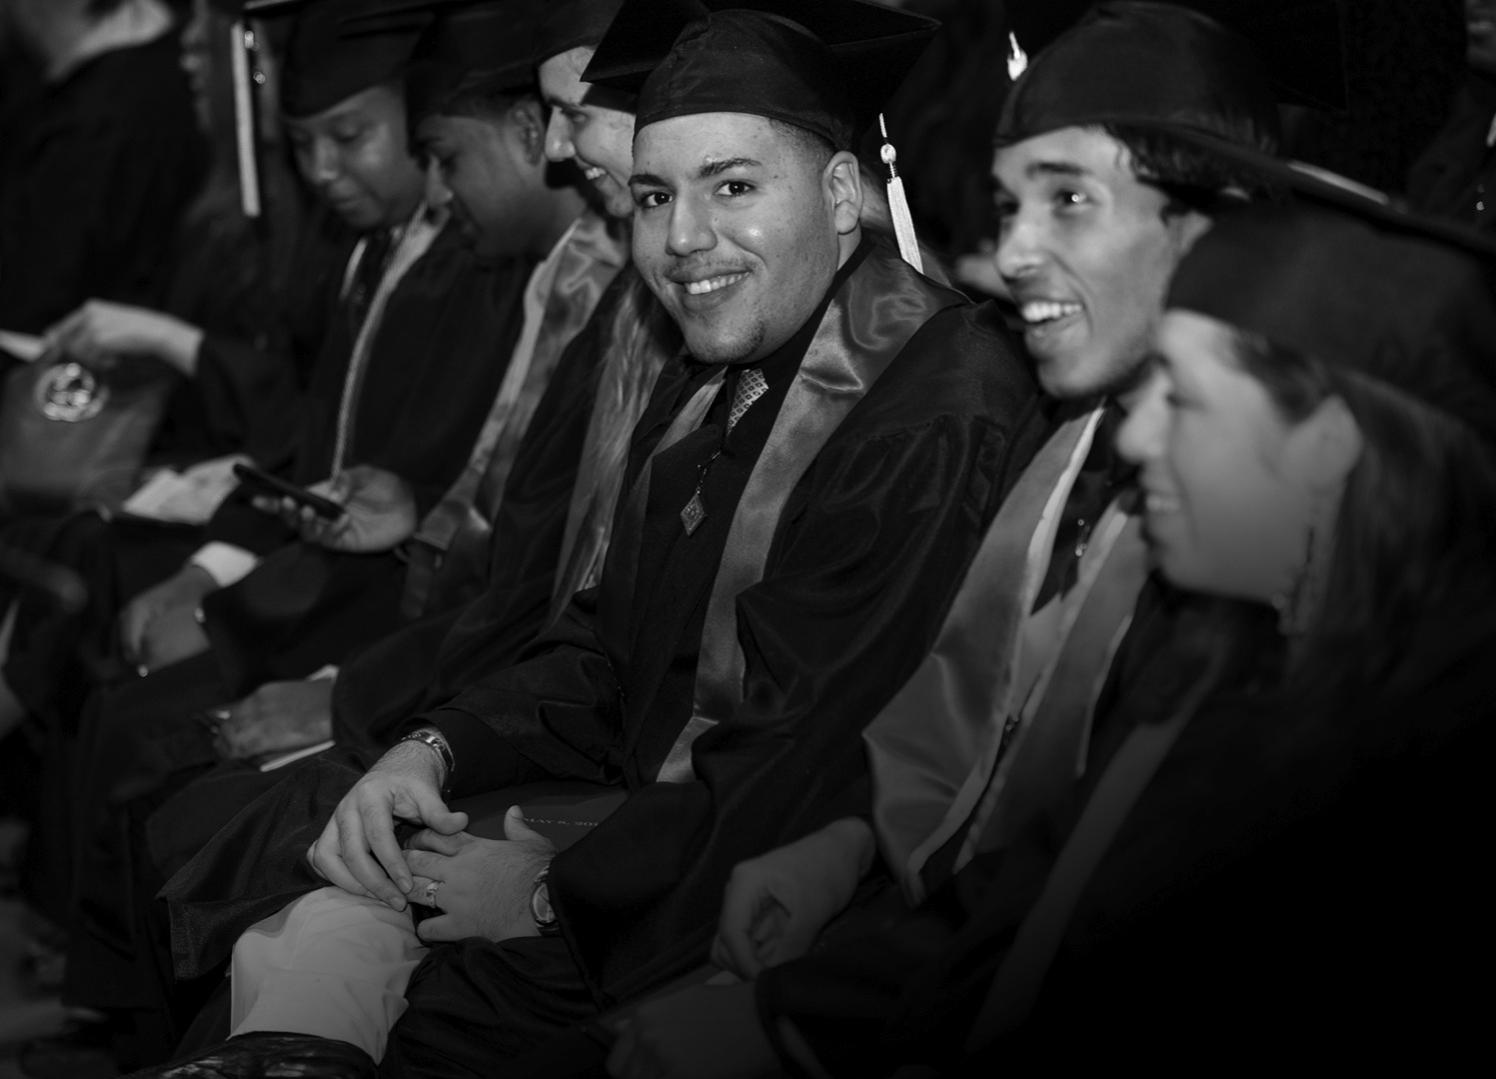
Theme 2
Clear pathways to credentials and other intentional structures to support students

Slide 18
Exceptional colleges have comprehensive student support systems that cross historic functional or curricular divisions:
Build new pathways to success, including narrowly defined course sequences, fully integrated learning communities, and block program structures.

Slide 19
Exceptional colleges have comprehensive student support systems that cross historic functional or curricular divisions:
Embed high-impact support services within the classroom (e.g., advising, registration, tutoring, note-taking guidance, career counseling).

Slide 20
Exceptional colleges have comprehensive student support systems that cross historic functional or curricular divisions:
Redesign systems from scratch (one-stop student service centers, new registration centers, etc.) and implement them college-wide rather than in small pilots.

Slide 21
Miami Dade College
Faculty and advisors were engaged to create new simple degree pathways for 60% of incoming students.
Result: New default curricula for five degree pathways that, together, serve 60 percent of all new students.

Slide 22
Lake Area Technical Institute
Structured, cohort-based, block-schedule programs ensure students stay on track.
Result: 76 percent graduation rate is among the nation’s highest.

Slide 23

Theme 3
Intentional focus on improving teaching and learning

Slide 24
Exceptional colleges set the expectation that faculty and staff
will continually improve their own practices:
Faculty engaged in
self-assessment and eager
to improve their instruction
to better serve students.
Notes:
They take seriously the scholarship of teaching and learning and make intentional efforts to improve the quality of instruction.

Slide 25
Exceptional colleges set the expectation that faculty and staff
will continually improve their own practices:
Explicit connections between individual student learning
and larger measures of
course, program, and
institution success.

Slide 26
Exceptional colleges set the expectation that faculty and staff
will continually improve their own practices:
A systematic use of evidence
of students’ learning outcomes to drive improvements
in instruction.

Slide 27
Exceptional colleges set the expectation that faculty and staff
will continually improve their own practices:
Tenure and promotion models supported by systematic collection and discussion of data on student learning outcomes.

Slide 28
West Kentucky Community and Technical College
Widespread development and use of assessments to improve instruction, driven by leaders engaging in multiple strategies to create urgency around the need to improve student learning.
Result: Strong graduation rates and dramatically improved reading scores.

Slide 29

Theme 4
Consistent, systematic,
and strategic use of data
to improve practice

Slide 30
Exceptional colleges strategically use student data:
Data are distributed consistently throughout the institution that reflect the
focus on student success.

Slide 31
Exceptional colleges strategically use student data:
Data help everyone understand students’ longer-term success—such as labor market outcomes and post-transfer academic success.

Slide 32
Exceptional colleges strategically use student data:
Faculty and staff are given structured time and space to meet, analyze, and discuss data on student outcomes.
Exceptional colleges go beyond data-driven practice; they have cultures of inquiry and use varied forms of information to systematically diagnose, assess, benchmark, and make decisions.

Slide 33
Walla Walla Community College
Data on labor market trends and completion drive consistent, iterative changes in programs and communications with students.
Result: Student outcomes are used to decide which program to open, expand, and close (even when fully enrolled).

Slide 34

Theme 5
Integrated structures that link the college to the broader community for the benefit of students

Slide 35
Exceptional colleges build new structures to link the
college to its community:
Build strong ties with regional industries to design curricula for the jobs that exist to anticipate growing industries and help students get good jobs.
Notes:
Trajectory - from high schools, work, military, or unemployment, and on to jobs of four-year institutions
They create a seamless experiences for students

Slide 36
Exceptional colleges build new structures to link the
college to its community:
Work with K-12 districts
to align academic requirements and implement early-warning and college-prep systems
to reduce the need for
remedial education.

Slide 37
Exceptional colleges build new structures to link the
college to its community:
Work with four-year colleges to develop collaborative programs, guaranteed transfer, and aligned academic requirements for transfer.

Slide 38
Exceptional colleges build new structures to link the
college to its community:
Make the college a vital community asset, building brand recognition and attracting new resources
that benefit students.

Slide 39
Santa Barbara
City College
A formal relationship between the college and the local school district has yielded a mandatory college-preparatory curriculum for high school students designed together by high school teachers and college faculty.
Result: Very strong student success rates, including for the large number of Hispanic students it enrolls from
the local K-12 system.

Slide 40
Valencia College
Leaders worked with the University of Central Florida to develop a program that guarantees university admission to Valencia graduates, locate a facility on Valencia’s main campus, and ensure that transfer is seamless for students.
Result: UCF enrolls 10,000 Valencia transfers who earn grades and bachelor’s degrees at rates nearly identical to the students who started at UCF.

Slide 41
For more information, contact:
Josh Wyner
The Aspen Institute
One DuPont Circle NW, Suite 700
Washington, DC 20036
Josh.Wyner@aspeninstitute.org
(202) 736-2286
www.aspeninstitute.org/college-excellence

