Slide 1
The Qualities of Exceptional Community College Leaders
Pre-conference Workshop:
Texas Community College Instructional Leaders
October 8, 2014
Joshua S. Wyner
Vice President,
Executive Director, College Excellence Program
The Aspen Institute

Slide 2
Aspen College Excellence Program
The Aspen College Excellence Program works to advance higher education practices, policies, and leadership that significantly improve student outcomes in four areas:
Completion. Do students earn degrees and other meaningful credentials while in college?
Equity. Do colleges work to ensure equitable outcomes for minority and low-income students, and others often underserved?
Labor market. Do graduates get well-paying jobs?
Learning. Do colleges and their faculty set expectations for what students should learn, measure whether they are doing so, and use that information to improve?

Slide 3
Agenda
Framing the Challenge
Original research on the qualities of exceptional leaders from the Aspen Institute and Achieving the Dream
Strengthening the hiring process
Improving professional development

Slide 4
Framing the Challenge
Why Focus on Leadership Now?
Environment is changing rapidly…
Changing student demographics
Increasing accountability
Diminished state budgets
Expanding technology
Increased competition
Turnover is accelerating: 500 new community college presidents in next five years (AACC)

Slide 5
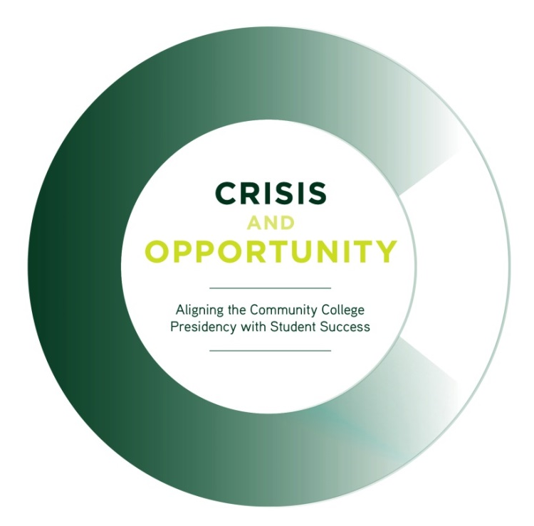
Original Research: Crisis & Opportunity
In partnership with Achieving the Dream, Aspen explored three core questions:
What are the qualities of excellent community college presidents?
What qualities do trustees value in hiring?
What skills do education and professional development programs emphasize?

Slide 6
Findings: Five Qualities of Exceptional Leaders
1
Deep commitment to student access & success
2
Willingness to take risks
3
Excellent internal change management ability
4
Strong, broad vision for the college, reflected
in external partnerships
5
Skill in fundraising and resource allocation tied to
student success goals

Slide 7
Discussion questions
What on this list is most frequent among current leaders?
What is least frequent?
Why are the more common attributes present on the list?
Why are the less common attributes infrequent?

Slide 8
Strengthening the Hiring Process
Gap Analysis: Hiring
Ideally… |  | In reality…
Excellent presidents demonstrate urgency and are willing to take risks to improve student success. |  | Trustees sometimes value risk-averse candidates, focusing on fiscal stability and strong external relationships.
Excellent presidents focus about half of their time on internal operations, implementing change strategies aimed at improving student outcomes. |  | Trustees often overemphasize capacity to build external relationships, not internal skills needed to inspire and implement significant change.
Excellent presidents focus much of their external efforts on building partnerships that can support improvements in student outcomes. |  | Trustees value candidates who can build legislative and corporate relationships, but not new structures for student success.
Excellent presidents inspire and empower others to succeed, relishing not their own success as much as the success of others who are essential to improving student outcomes. |  | Trustees sometimes look for charismatic presidents, overlooking their ability to inspire/share success.

Slide 9
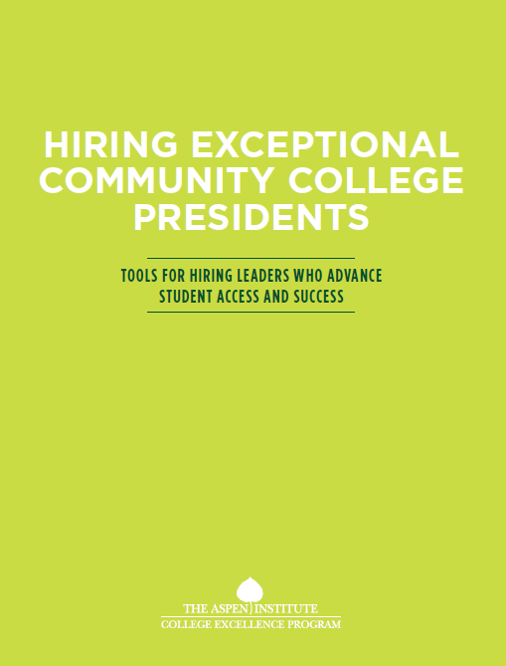
Tools for Hiring Leaders who Advance
Student Access and Success

Slide 10
Strengthening the Hiring Process:
Set Strategic Priorities & Hiring Criteria
Tool #1: Protocol to Align Priorities to Hiring Criteria
What are the college’s strategic goals related to student access and success?
How well is the college achieving student access and success?
What kinds of changes within and outside the institution will the new president need to accomplish to achieve the student access and success goals?
What are the five to ten most important qualities we must identify in our next president to achieve our student success goals?
Where are we most likely to find a leader who will demonstrate these qualities?

Slide 11
Strengthening the Hiring Process:
Recruit Candidates
Tool #2: Job Announcement Language
Sample first line: “The President leads the institution in advancing students toward attainment of their educational and career-readiness goals by effectively marshaling its instructional and support resources to improve student outcomes.”
Language related to being “results-oriented”: “The President will develop a culture of inquiry and evidence to support a results-oriented approach across the institution.”

Slide 12
Strengthening the Hiring Process:
Assess Candidates - Examples
Tool #3: Scenario-Based Writing Exercise
“You discover soon after assuming your presidency that surveys of the college’s recent graduates and data from the state about post-graduation earning and employment rates reveal that (1) 20% of graduates are unemployed and (2) graduates’ average salaries are significantly lower than salaries of others with associate’s degrees in the college’s service area. How would you as president respond? With whom would you share the data and how? What steps would you consider to improve these outcomes? How quickly can things be turned around so outcomes for graduates improve?”

Slide 13
Strengthening the Hiring Process:
Assess Candidates - Examples
Tool #4: Questions for In-Person Interviews
“How should a college president view student access and success relative to other priorities?”
“Please discuss how you think about systematically bringing about change in a college culture to improve student access and success...”
“What dimensions of implementation pose the greatest challenge for a community college? Can you provide an example? How did you handle that challenge?

Slide 14
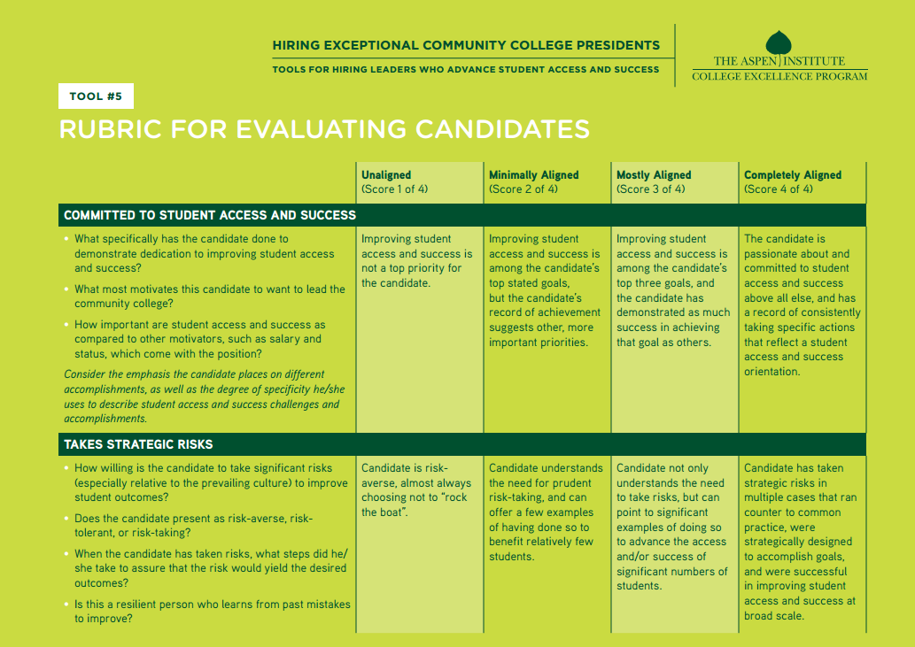
Strengthening the Hiring Process:
Assess Candidates - Examples
Tool #5: Rubric for Evaluating Candidates

Slide 15
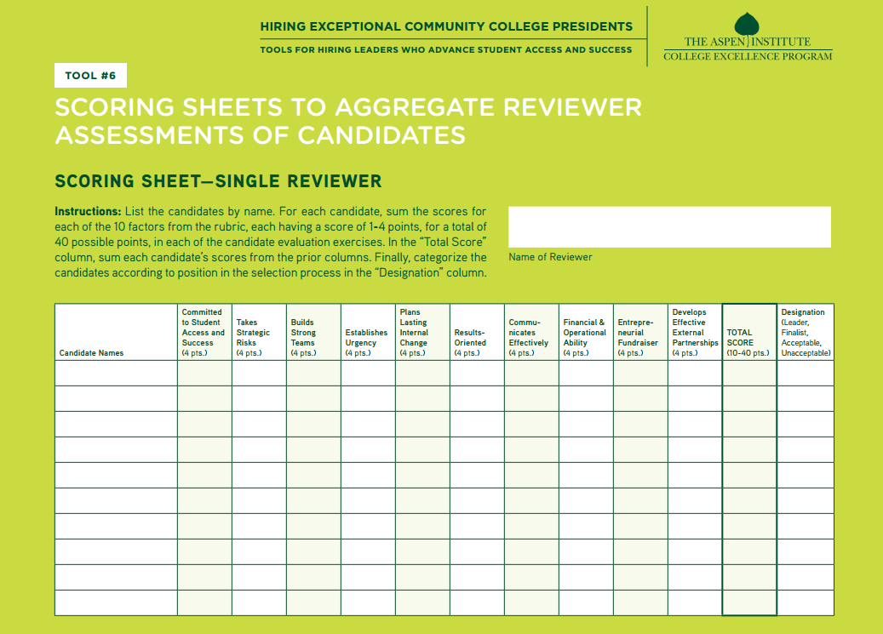
Strengthening the Hiring Process:
Assess Candidates - Examples
Tool #6: Scoring Sheets to Aggregate Assessments of Candidates

Slide 16
Strengthening the Hiring Process:
Confirm the Choice
Tool #7: Protocol for Reference Checks
Language related to “taking strategic risks”: “What was the most significant change the candidate brought about during his/her tenure? How did the candidate accomplish that?”
Language related to “communicating effectively”: “Was the candidate able to communicate in ways that influenced stakeholders to support key strategic objectives?”

Slide 17
Strengthening the Hiring Process
What in the hiring process could lead to selecting risk-averse leaders?
What is least frequent?
Why are the more common attributes present on the list?
Why are the less common attributes infrequent?

Slide 18
Improving Professional Development
Gap Analysis: Education/Professional Development
Ideally… |  | In reality…
Excellent presidents capable of managing campus based change to increase student success at scale. |  | Educational programs focus on traditional aspects of management (budgeting, enrollment, isolated student success initiatives).
Excellent presidents view their colleges as part of ecosystems in which external actors are essential to student success. |  | Educational programs focus almost exclusively on internal community college matters.
Excellent presidents apply their skills in each area of competency (budgeting, hiring, communicating) with an eye towards student success. |  | Education programs often teach core competencies in ways unrelated to student success goals.
Excellent presidents take risks such as reallocating resources and admitting low-levels of student success. |  | Education programs focus on the “right way” to do things, which often entails avoiding risks.

Slide 19
Improving Professional Development
Leadership Curricular Resources
Student Success
What It Means and Why It Matters
Internal Change
Changing Culture to Deeply and Sustainably Reform Institutions
Collective Impact
Galvanizing Action Among All Entities that Play a Role in Student Success

Slide 20
Improving Professional Development
Student Success
Framing & Measuring Student Success
Equity as a Key Dimension of All Students’ Success
Authentic Leadership: What Student Success Means to You

Slide 21
Improving Professional Development
Internal Change:
Creating a Sustainable Culture of Student Success
What Students Experience
Defining Programs to Improve Completion
Reforming Developmental Education
Revamping First-Year Experiences for Improved Outcomes
Improving Teaching Practice

Slide 22
Improving Professional Development
Internal Change:
Creating a Sustainable Culture of Student Success
Conditions for Student Success
Budgeting and Allocating Resources for Student Success
Communicating Effectively to Accelerate Change
Adopting Technology as a Tool for Student Success
Working with the Board on Student Success

Slide 23
Improving Professional Development
Collective Impact
Building New Structure for Student Success with…
…K-12 to Strengthen College Readiness
…Employers to Align Skills Development
…4-Year Institutions to Improve Transfer Outcomes
…Community-based Organizations for Student Services

Slide 24
Improving Professional Development
What is the typical process for professionally developing future presidents?
Are there certain areas of professional development that get more attention than others?
What are some of the areas you believe deserve more attention?

Slide 25
For more information, contact:
Joshua S. Wyner
The Aspen Institute
One DuPont Circle NW, Suite 700
Washington, DC 20036
Josh.Wyner@aspeninstitute.org
(202) 736-2286
www.aspeninstitute.org/college-excellence

